Slide 1
Chapter 1
Basic Simulation Modeling

Slide 2
CONTENTS
1.1 The Nature of Simulation
1.2 Systems, Models, and Simulation
1.3 Discrete-Event Simulation
1.4 Simulation of a Single-Server Queueing System
1.5 Simulation of an Inventory System
1.6 Alternative Approaches to Modeling and Coding Simulations
1.7 Steps in a Sound Simulation Study
1.8 Other Types of Simulation
1.9 Advantages, Disadvantages, and Pitfalls of Simulation

Slide 3
1.1 THE NATURE OF SIMULATION
Simulation: Imitate the operations of a facility or process, usually via computer
  What’s being simulated is the system
  To study system, often make assumptions/approximations, both logical and mathematical, about how it works
  These assumptions form a model of the system
  If model structure is simple enough, could use mathematical methods to get exact information on questions of interest — analytical solution

Slide 4
1.1 The Nature of Simulation (cont’d.)
But most complex systems require models that are also complex (to be valid)
  Must be studied via simulation — evaluate model numerically and collect data to estimate model characteristics
Example: Manufacturing company considering extending its plant
  Build it and see if it works out?
  Simulate current, expanded operations — could also investigate many other issues along the way, quickly and cheaply

Slide 5
1.1 The Nature of Simulation (cont’d.)
Some (not all) application areas
  Designing and analyzing manufacturing systems
  Evaluating military weapons systems or their logistics requirements
  Determining hardware requirements or protocols for communications networks
  Determining hardware and software requirements for a computer system
  Designing and operating transportation systems such as airports, freeways, ports, and subways
  Evaluating designs for service organizations such as call centers, fast-food restaurants, hospitals, and post offices
  Reengineering of business processes
  Determining ordering policies for an inventory system
  Analyzing financial or economic systems

Slide 6
1.1 The Nature of Simulation (cont’d.)
Use, popularity of simulation
  Several conferences devoted to simulation, notably the Winter Simulation Conference (www.wintersim.org)
Surveys of use of OR/MS techniques (examples …)
  Longitudinal study (1973-1988): Simulation consistently ranked as one of the three most important techniques
  1294 papers in Interfaces (1997): Simulation was second only to the broad category of “math programming”

Slide 7
1.1 The Nature of Simulation (cont’d.)
Impediments to acceptance, use of simulation
  Models of large systems are usually very complex
    But now have better modeling software … more general, flexible, but still (relatively) easy to use
  Can consume a lot of computer time
    But now have faster, bigger, cheaper hardware to allow for much better studies than just a few years ago … this trend will continue
    However, simulation will also continue to push the envelope on computing power in that we ask more and more of our simulation models
  Impression that simulation is “just programming”
    There’s a lot more to a simulation study than just “coding” a model in some software and running it to get “the answer”
    Need careful design and analysis of simulation models – simulation methodology

Slide 8
1.2 SYSTEMS, MODELS, AND SIMULATION
System: A collection of entities (people, parts, messages, machines, servers, …) that act and interact together toward some end (Schmidt and Taylor, 1970)
  In practice, depends on objectives of study
  Might limit the boundaries (physical and logical) of the system
  Judgment call: level of detail (e.g., what is an entity?)
  Usually assume a time element – dynamic system
State of a system: Collection of variables and their values necessary to describe the system at that time
  Might depend on desired objectives, output performance measures
  Bank model: Could include number of busy tellers, time of arrival of each customer, etc.

Slide 9
1.2 Systems, Models, and Simulation (cont’d.)
Types of systems
  Discrete
    State variables change instantaneously at separated points in time
    Bank model: State changes occur only when a customer arrives or departs
  Continuous
    State variables change continuously as a function of time
    Airplane flight: State variables like position, velocity change continuously
Many systems are partly discrete, partly continuous

Slide 10
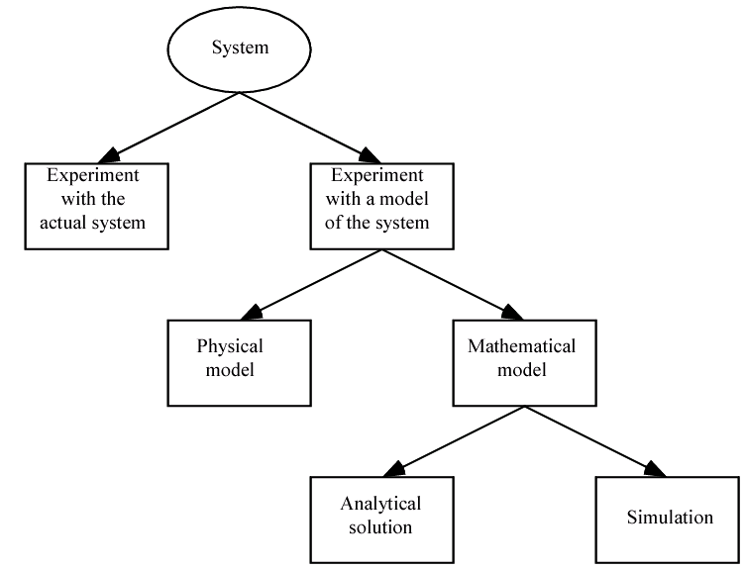
1.2 Systems, Models, and Simulation (cont’d.)
Ways to study a system
  Simulation is “method of last resort?” Maybe …
  But with simulation there’s no need (or less need) to “look where the light is”

Slide 11
1.2 Systems, Models, and Simulation (cont’d.)
Classification of simulation models
  Static vs. dynamic
  Deterministic vs. stochastic
  Continuous vs. discrete
Most operational models are dynamic, stochastic, and discrete – will be called discrete-event simulation models

Slide 12
1.3 DISCRETE-EVENT SIMULATION
Discrete-event simulation: Modeling of a system as it evolves over time by a representation where the state variables change instantaneously at separated points in time
  More precisely, state can change at only a countable number of points in time
  These points in time are when events occur
Event: Instantaneous occurrence that may change the state of the system
  Sometimes get creative about what an “event” is … e.g., end of simulation, make a decision about a system’s operation
Can in principle be done by hand, but usually done on computer

Slide 13
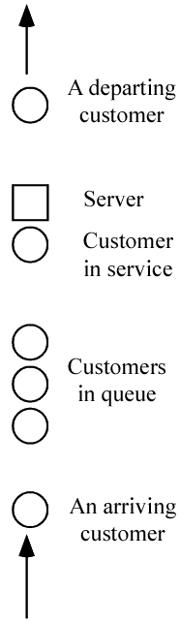
1.3 Discrete-Event Simulation (cont’d.)
Example: Single-server queue
  Estimate expected average delay in queue (line, not service)
  State variables
    Status of server (idle, busy) – needed to decide what to do with an arrival
    Current length of the queue – to know where to store an arrival that must wait in line
    Time of arrival of each customer now in queue – needed to compute time in queue when service starts
  Events
    Arrival of a new customer
    Service completion (and departure) of a customer
    Maybe – end-simulation event (a “fake” event) – whether this is an event depends on how simulation terminates (a modeling decision)

Slide 14
1.3.1 Time-Advance Mechanisms
Simulation clock: Variable that keeps the current value of (simulated) time in the model
  Must decide on, be consistent about, time units
  Usually no relation between simulated time and (real) time needed to run a model on a computer
Two approaches for time advance
  Next-event time advance (usually used) … described in detail below
  Fixed-increment time advance (seldom used) … Described in Appendix 1A
    Generally introduces some amount of modeling error in terms of when events should occur vs. do occur
    Forces a tradeoff between model accuracy and computational efficiency

Slide 15
1.3.1 Time-Advance Mechanisms (cont’d.)
More on next-event time advance
  Initialize simulation clock to 0
  Determine times of occurrence of future events – event list
  Clock advances to next (most imminent) event, which is executed
    Event execution may involve updating event list
  Continue until stopping rule is satisfied (must be explicitly stated)
  Clock “jumps” from one event time to the next, and doesn’t “exist” for times between successive events … periods of inactivity are ignored

Slide 16
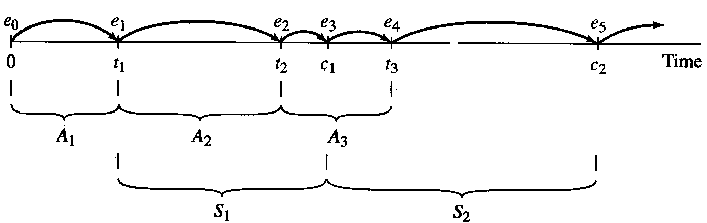
1.3.1 Time-Advance Mechanisms (cont’d.)
Next-event time advance for the single-server queue
    t_{i} = time of arrival of ith customer (t₀ = 0)
    A_{i} = t_{i} – t_{i-1} = interarrival time between (i-1)st and ith customers (usually assumed to be a random variable from some probability distribution)
    S_{i} = service-time requirement of ith customer (another random variable)
    D_{i} = delay in queue of ith customer
    C_{i} = t_{i} + D_{i} + S_{i} = time ith customer completes service and departs
    e_{j} = time of occurrence of the jth event (of any type), j = 1, 2, 3, …
  Possible trace of events (detailed narrative in text)

Slide 17
1.3.2 Components and Organization of a Discrete-Event Simulation Model
Each simulation model must be customized to target system
But there are several common components, general organization
  System state – variables to describe state
  Simulation clock – current value of simulated time
  Event list – times of future events (as needed)
  Statistical counters – to accumulate quantities for output
  Initialization routine – initialize model at time 0
  Timing routine – determine next event time, type; advance clock
  Event routines – carry out logic for each event type
  Library routines – utility routines to generate random variates, etc.
  Report generator – to summarize, report results at end
  Main program – ties routines together, executes them in right order

Slide 18
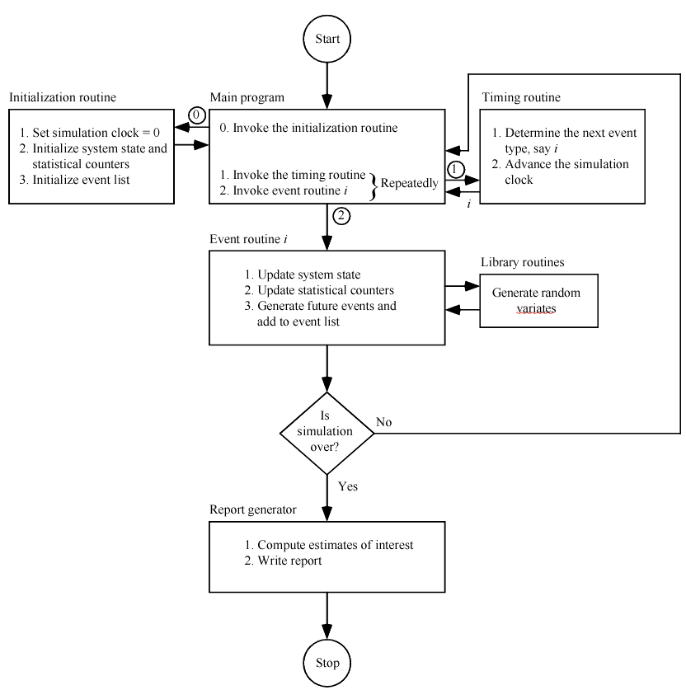
1.3.2 Components and Organization of a Discrete-Event Simulation Model (cont’d.)

Slide 19
1.3.2 Components and Organization of a Discrete-Event Simulation Model (cont’d.)
More on entities
  Objects that compose a simulation model
  Usually include customers, parts, messages, etc. … may include resources like servers
  Characterized by data values called attributes
  For each entity resident in the model there’s a record (row) in a list, with the attributes being the columns
Approaches to modeling
  Event-scheduling – as described above, coded in general-purpose language
  Process – focuses on entities and their “experience,” usually requires special-purpose simulation software

Slide 20
1.4 SIMULATION OF A SINGLE-SERVER QUEUEING SYSTEM
Will show how to simulate a specific version of the single-server queueing system
Book contains code in FORTRAN and C … slides will focus only on C version
Though simple, it contains many features found in all simulation models

Slide 21
1.4.1 Problem Statement
Recall single-server queueing model
Assume interarrival times are independent and identically distributed (IID) random variables
Assume service times are IID, and are independent of interarrival times
Queue discipline is FIFO
Start empty and idle at time 0
First customer arrives after an interarrival time, not at time 0
Stopping rule: When nth customer has completed delay in queue (i.e., enters service) … n will be specified as input

Slide 22
1.4.1 Problem Statement (cont’d.)
Quantities to be estimated
  Expected average delay in queue (excluding service time) of the n customers completing their delays
    Why “expected?”
  Expected average number of customers in queue (excluding any in service)
    A continuous-time average
    Area under Q(t) = queue length at time t, divided by T(n) = time simulation ends … see book for justification and details
  Expected utilization (proportion of time busy) of the server
    Another continuous-time average
    Area under B(t) = server-busy function (1 if busy, 0 if idle at time t), divided by T(n) … justification and details in book
  Many others are possible (maxima, minima, time or number in system, proportions, quantiles, variances …)
Important: Discrete-time vs. continuous-time statistics

Slide 23
1.4.2 Intuitive Explanation
Given (for now) interarrival times (all times are in minutes):
  0.4, 1.2, 0.5, 1.7, 0.2, 1.6, 0.2, 1.4, 1.9, …
Given service times:
  2.0, 0.7, 0.2, 1.1, 3.7, 0.6, …
n = 6 delays in queue desired
“Hand” simulation:
  Display system, state variables, clock, event list, statistical counters … all after execution of each event
  Use above lists of interarrival, service times to “drive” simulation
  Stop when number of delays hits n = 6, compute output performance measures

Slide 24
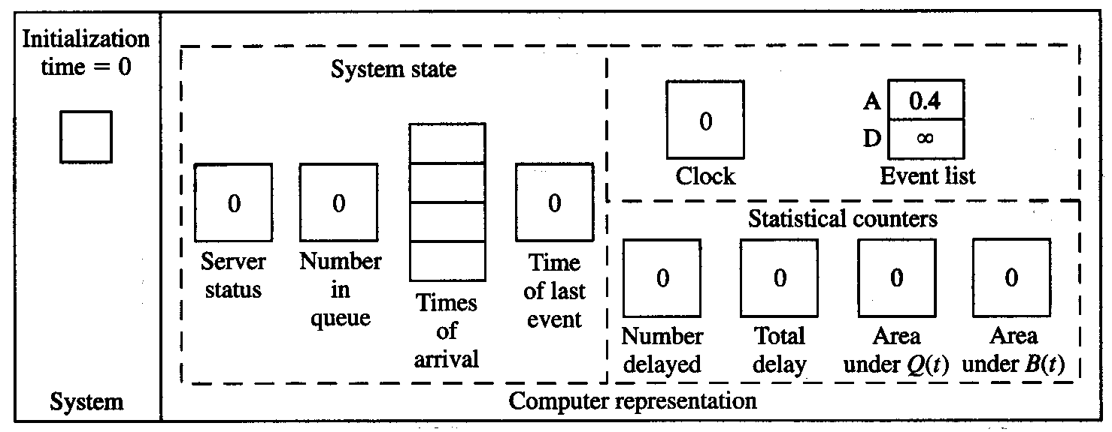
1.4.2 Intuitive Explanation (cont’d)
Status shown is after all changes have been made in each case …
Interarrival times: 0.4, 1.2, 0.5, 1.7, 0.2, 1.6, 0.2, 1.4, 1.9, …
Service times: 2.0, 0.7, 0.2, 1.1, 3.7, 0.6, …

Slide 25
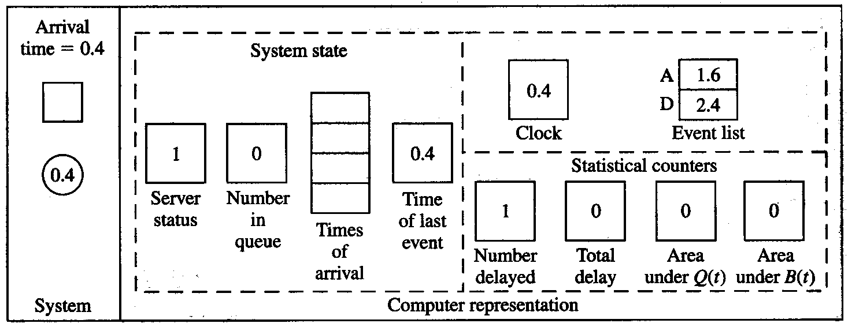
1.4.2 Intuitive Explanation (cont’d)
Interarrival times: 0.4, 1.2, 0.5, 1.7, 0.2, 1.6, 0.2, 1.4, 1.9, …
Service times: 2.0, 0.7, 0.2, 1.1, 3.7, 0.6, …

Slide 26
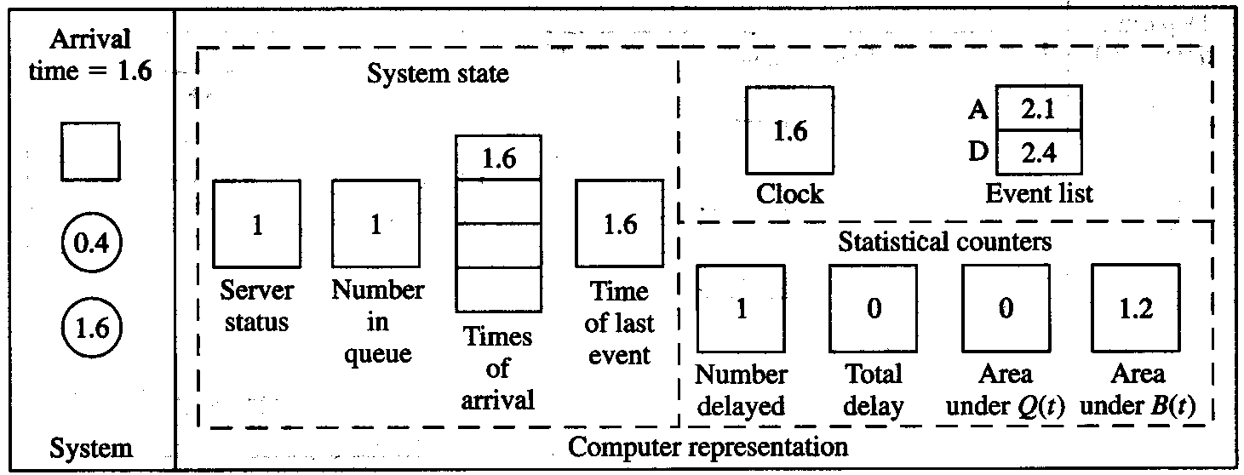
1.4.2 Intuitive Explanation (cont’d)
Interarrival times: 0.4, 1.2, 0.5, 1.7, 0.2, 1.6, 0.2, 1.4, 1.9, …
Service times: 2.0, 0.7, 0.2, 1.1, 3.7, 0.6, …

Slide 27
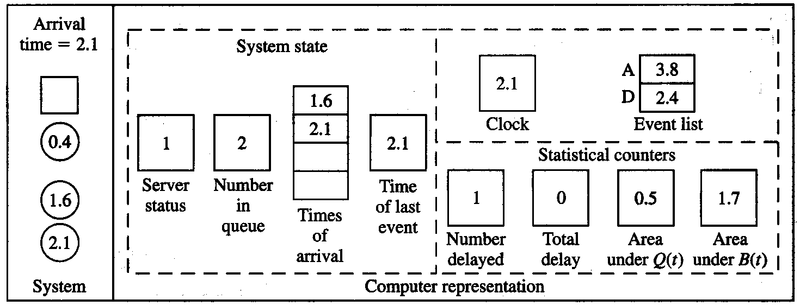
1.4.2 Intuitive Explanation (cont’d)
Interarrival times: 0.4, 1.2, 0.5, 1.7, 0.2, 1.6, 0.2, 1.4, 1.9, …
Service times: 2.0, 0.7, 0.2, 1.1, 3.7, 0.6, …

Slide 28
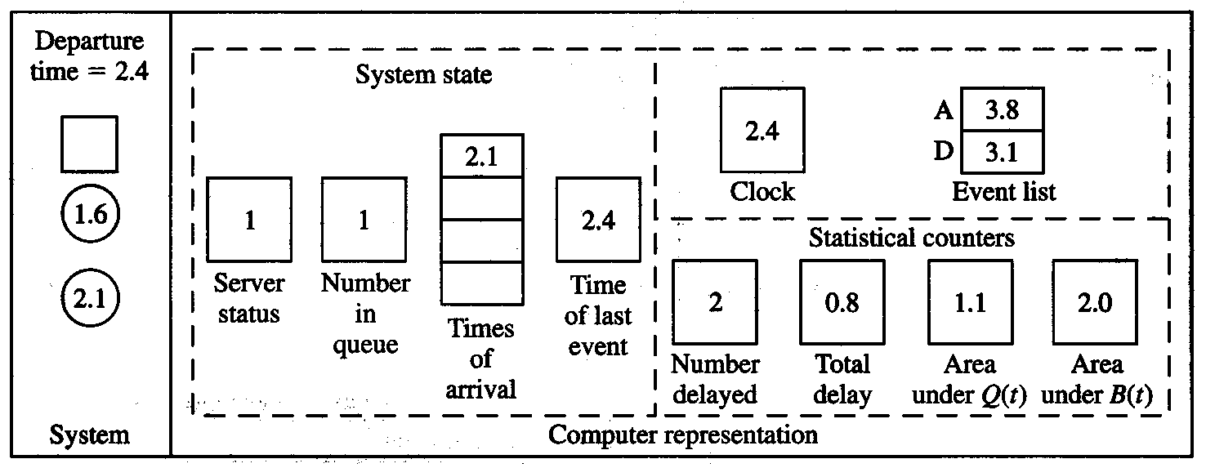
1.4.2 Intuitive Explanation (cont’d)
Interarrival times: 0.4, 1.2, 0.5, 1.7, 0.2, 1.6, 0.2, 1.4, 1.9, …
Service times: 2.0, 0.7, 0.2, 1.1, 3.7, 0.6, …

Slide 29
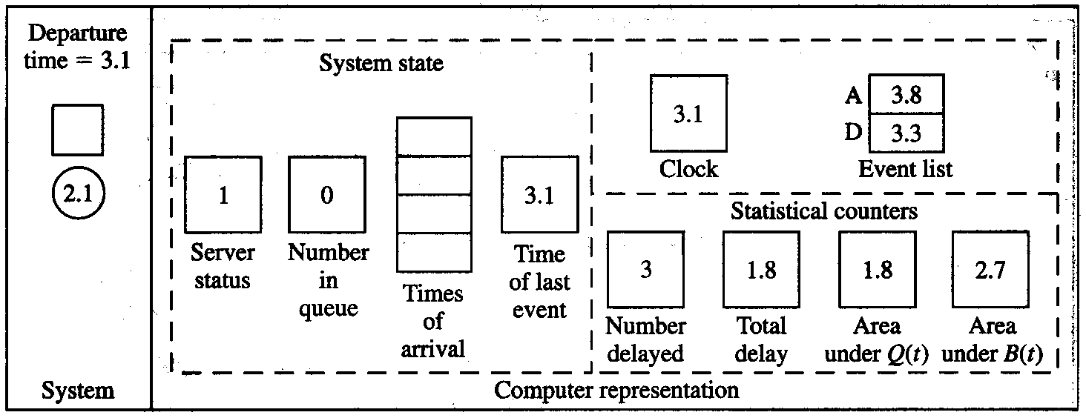
1.4.2 Intuitive Explanation (cont’d)
Interarrival times: 0.4, 1.2, 0.5, 1.7, 0.2, 1.6, 0.2, 1.4, 1.9, …
Service times: 2.0, 0.7, 0.2, 1.1, 3.7, 0.6, …

Slide 30
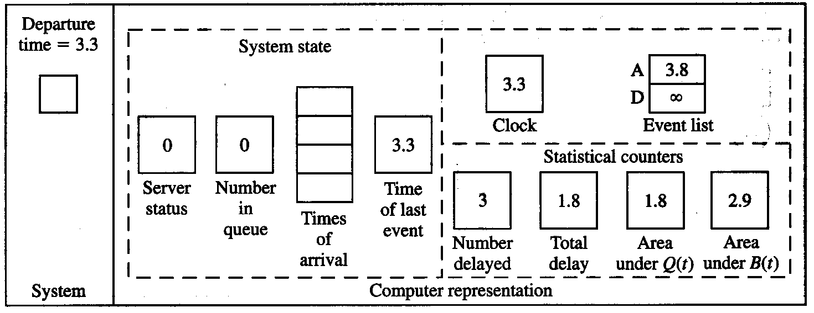
1.4.2 Intuitive Explanation (cont’d)
Interarrival times: 0.4, 1.2, 0.5, 1.7, 0.2, 1.6, 0.2, 1.4, 1.9, …
Service times: 2.0, 0.7, 0.2, 1.1, 3.7, 0.6, …

Slide 31
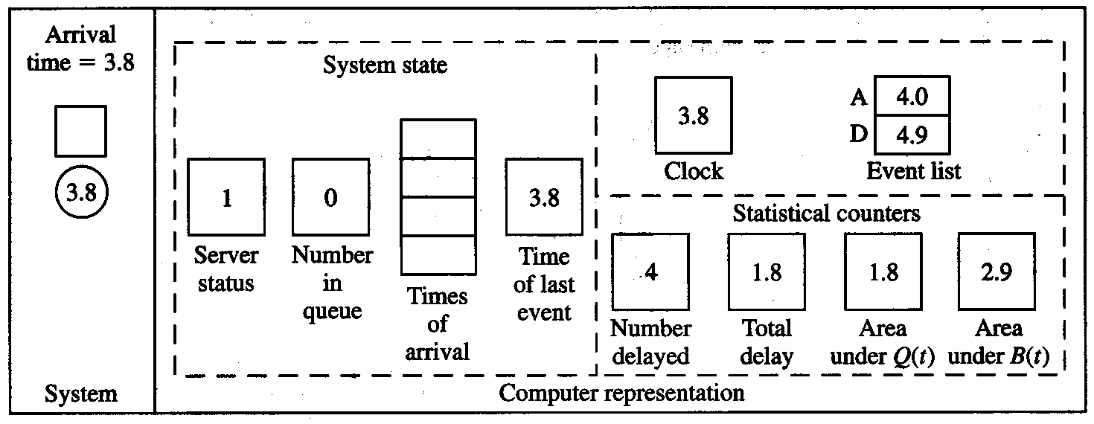
1.4.2 Intuitive Explanation (cont’d)
Interarrival times: 0.4, 1.2, 0.5, 1.7, 0.2, 1.6, 0.2, 1.4, 1.9, …
Service times: 2.0, 0.7, 0.2, 1.1, 3.7, 0.6, …

Slide 32
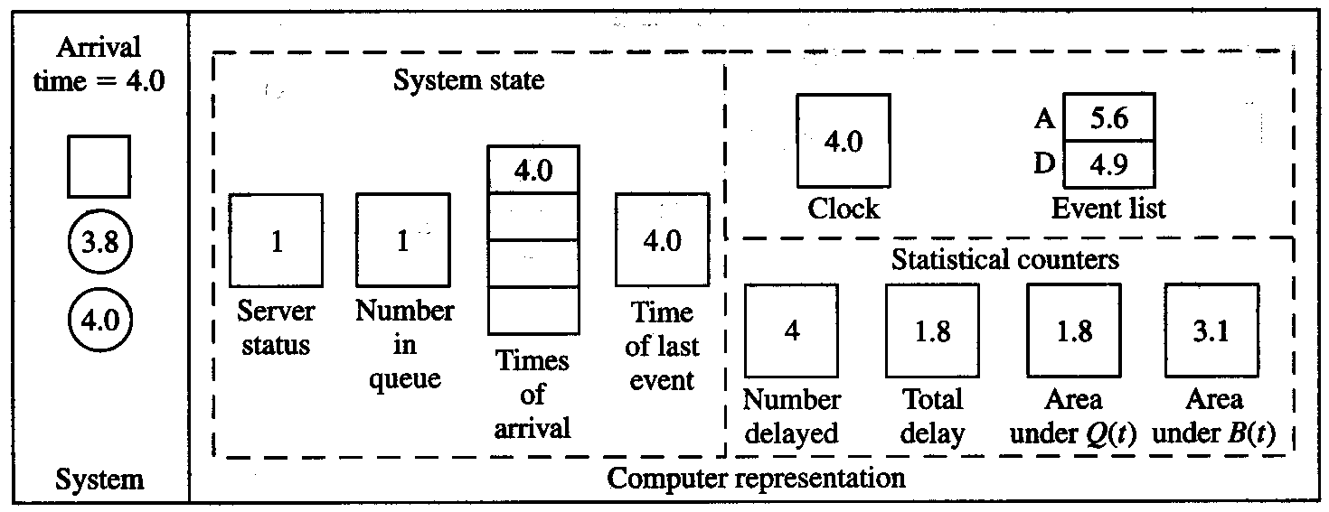
1.4.2 Intuitive Explanation (cont’d)
Interarrival times: 0.4, 1.2, 0.5, 1.7, 0.2, 1.6, 0.2, 1.4, 1.9, …
Service times: 2.0, 0.7, 0.2, 1.1, 3.7, 0.6, …

Slide 33
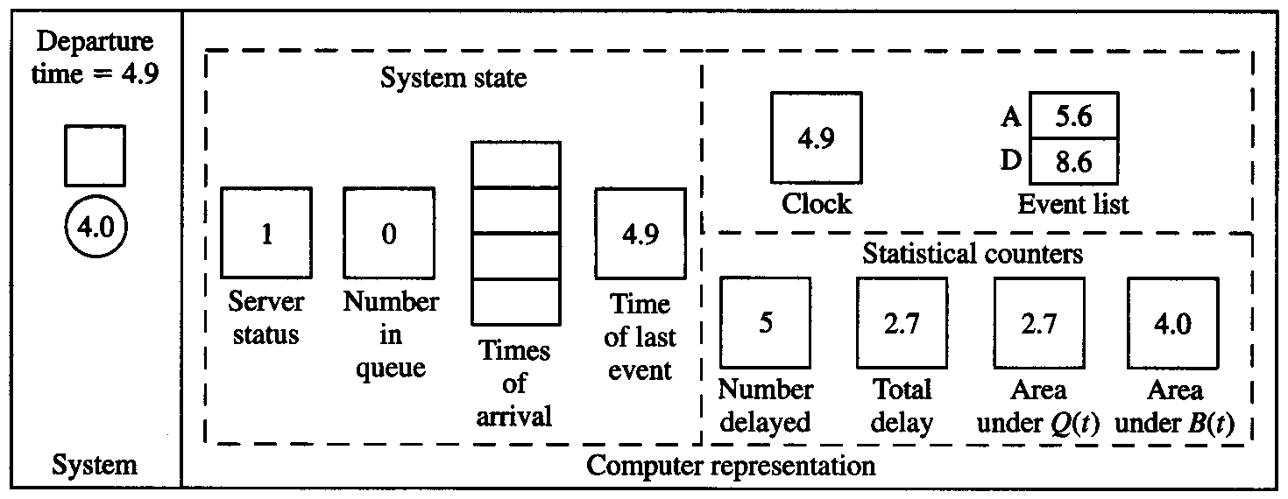
1.4.2 Intuitive Explanation (cont’d)
Interarrival times: 0.4, 1.2, 0.5, 1.7, 0.2, 1.6, 0.2, 1.4, 1.9, …
Service times: 2.0, 0.7, 0.2, 1.1, 3.7, 0.6, …

Slide 34
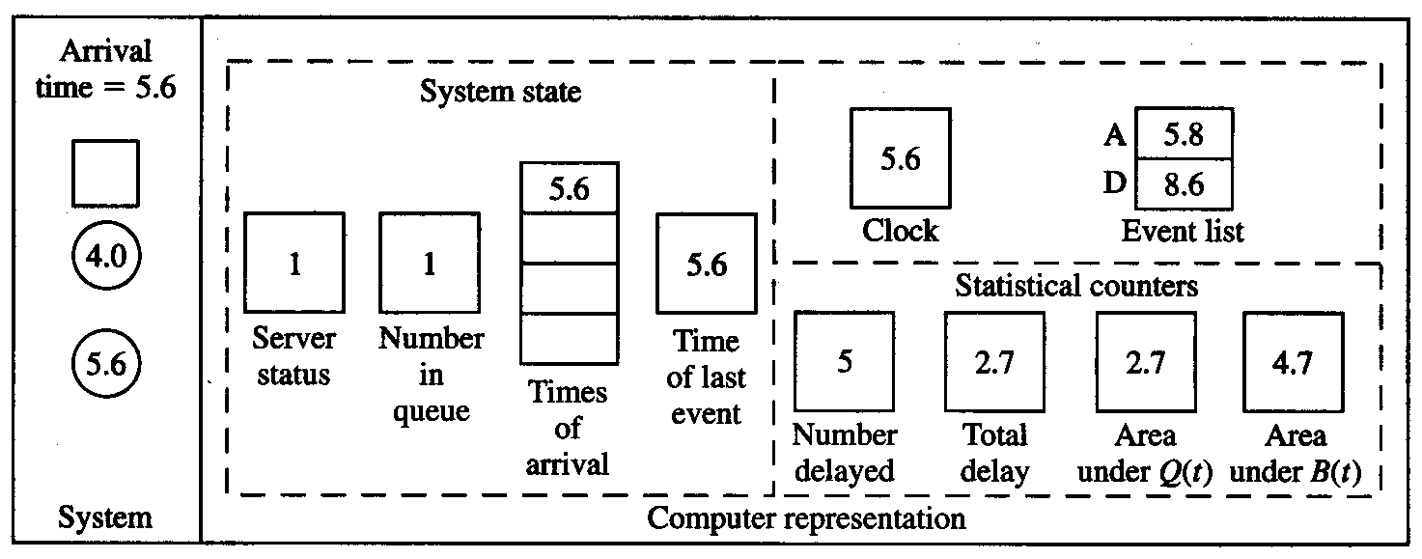
1.4.2 Intuitive Explanation (cont’d)
Interarrival times: 0.4, 1.2, 0.5, 1.7, 0.2, 1.6, 0.2, 1.4, 1.9, …
Service times: 2.0, 0.7, 0.2, 1.1, 3.7, 0.6, …

Slide 35
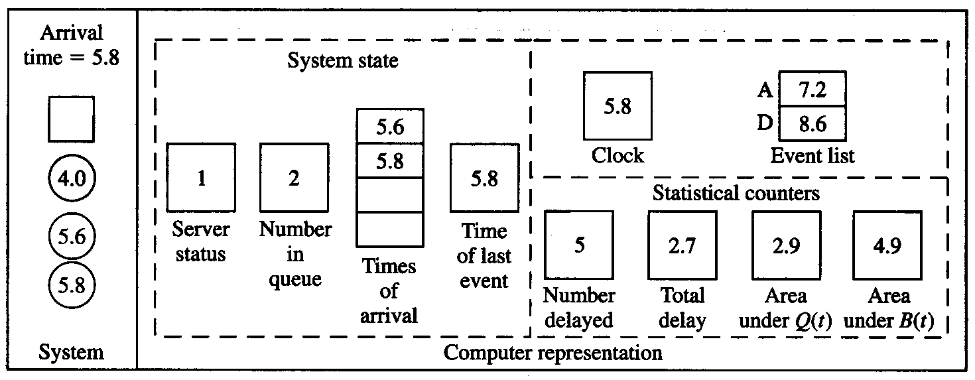
1.4.2 Intuitive Explanation (cont’d)
Interarrival times: 0.4, 1.2, 0.5, 1.7, 0.2, 1.6, 0.2, 1.4, 1.9, …
Service times: 2.0, 0.7, 0.2, 1.1, 3.7, 0.6, …

Slide 36
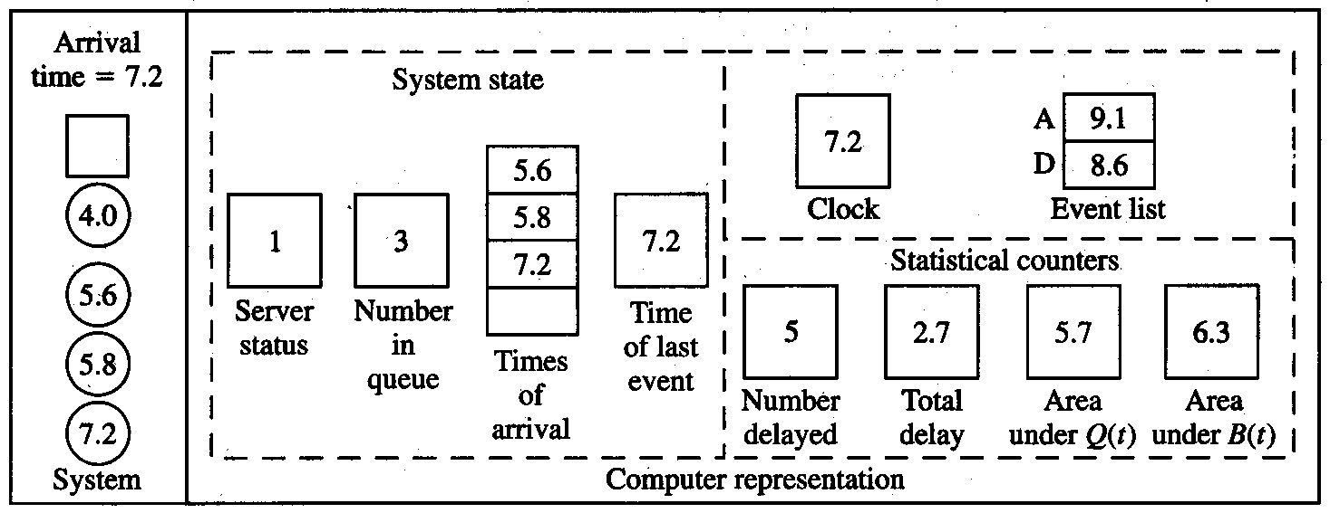
1.4.2 Intuitive Explanation (cont’d)
Interarrival times: 0.4, 1.2, 0.5, 1.7, 0.2, 1.6, 0.2, 1.4, 1.9, …
Service times: 2.0, 0.7, 0.2, 1.1, 3.7, 0.6, …

Slide 37
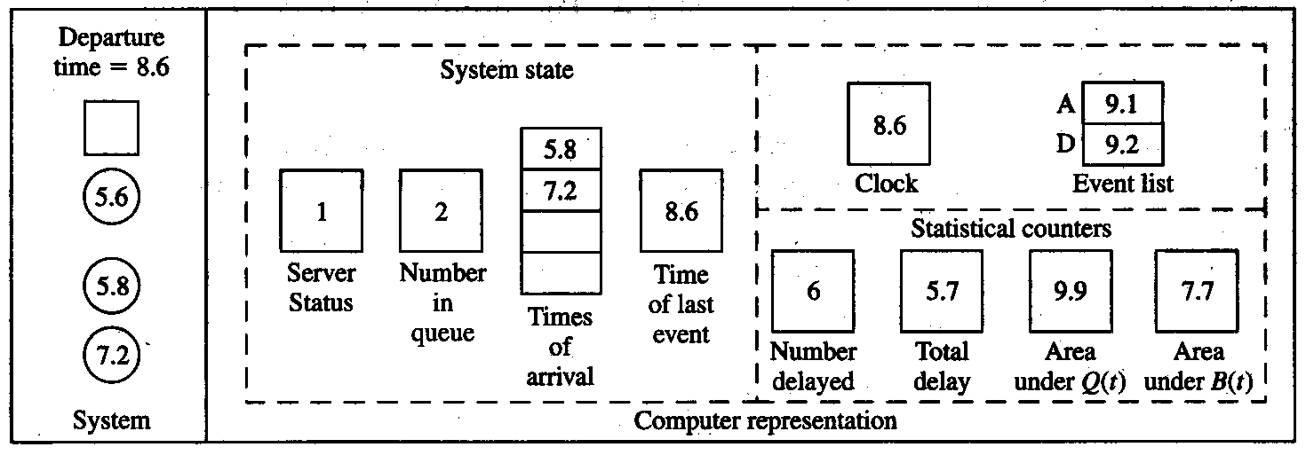
1.4.2 Intuitive Explanation (cont’d)
Interarrival times: 0.4, 1.2, 0.5, 1.7, 0.2, 1.6, 0.2, 1.4, 1.9, …
Service times: 2.0, 0.7, 0.2, 1.1, 3.7, 0.6, …
Final output performance measures:
Average delay in queue = 5.7/6 = 0.95 min./cust.
Time-average number in queue = 9.9/8.6 = 1.15 custs.
Server utilization = 7.7/8.6 = 0.90 (dimensionless)

Slide 38
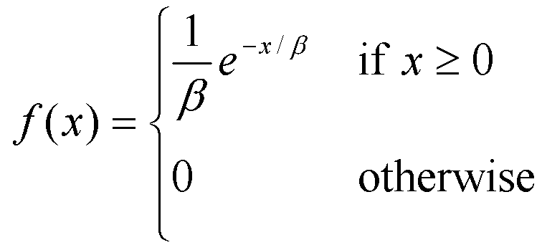
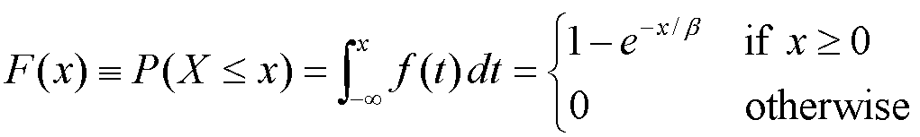
1.4.3 Program Organization and Logic
C program to do this model (FORTRAN as well is in book)
  Event types: 1 for arrival, 2 for departure
  Modularize for initialization, timing, events, library, report, main
Changes from hand simulation:
  Stopping rule: n = 1000 (rather than 6)
  Interarrival and service times “drawn” from an exponential distribution (mean β = 1 for interarrivals, 0.5 for service times)
    Density function
    Cumulative distribution function

Slide 39
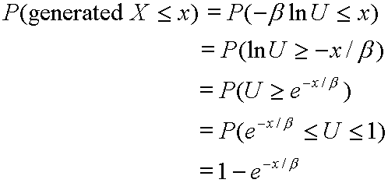
1.4.3 Program Organization and Logic (cont’d.)
How to “draw” (or generate) an observation (variate) from an exponential distribution?
Proposal:
  Assume a perfect random-number generator that generates IID variates from a continuous uniform distribution on [0, 1] … denoted the U(0, 1) distribution … see Chap. 7
  Algorithm:
    1. Generate a random number U
    2. Return X = – β ln U
  Proof that algorithm is correct:

Slide 40
1.4.5 C Program;
1.4.6 Simulation Output and Discussion
Refer to pp. 30, 31, 42-48 in the book (Figures 1.8, 1.9, 1.19-1.27) and the file mm1.c
  Figure 1.19 – external definitions (at top of file)
  Figure 1.20 – function main
  Figure 1.21 – function initialize
  Figure 1.22 – function timing
  Figure 1.23 – function arrive (flowchart: Figure 1.8)
  Figure 1.24 – function depart (flowchart: Figure 1.9)
  Figure 1.25 – function report
  Figure 1.26 – function update_time_avg_stats
  Figure 1.27 – function expon
  Figure 1.28 – output report mm1.out
    Are these “the” answers?
    Steady-state vs. terminating?
    What about time in queue vs. just time in system?

Slide 41
1.4.7 Alternative Stopping Rules
Stop simulation at (exactly) time 8 hours (= 480 minutes), rather than whenever n delays in queue are completed
  Before, final value of simulation clock was a random variable
  Now, number of delays completed will be a random variable
Introduce an artificial “end-simulation” event (type 3)
  Schedule it on initialization
  Event routine is report generator
  Be sure to update continuous-time statistics to end
Changes in C code (everything else is the same)
  Figure 1.33 – external definitions
  Figure 1.34 – function main
  Figure 1.35 – function initialize
  Figure 1.36 – function report
  Figure 1.37 – output report mm1alt.out

Slide 42
1.4.8 Determining the Events and Variables
For complex models, it might not be obvious what the events are
Event-graph method (Schruben 1983, and subsequent papers) gives formal graph-theoretic method of analyzing event structure
Can analyze what needs to be initialized, possibility of combining events to simplify model
Software package (SIGMA) to build, execute a simulation model via event-graph representation

Slide 43
1.5 SIMULATION OF AN INVENTORY SYSTEM;
1.5.1 Problem Statement
Single-product inventory
Decide how many items to have in inventory for the next
n = 120 months; initially (time 0) have 60 items on hand
Demands against inventory
  Occur with inter-demand time ~ exponential with mean 0.1 month
  Demand size = 1, 2, 3, 4 with resp. probabilities 1/6, 1/3, 1/3, 1/6
Inventory review, reorder – stationary (s, S) policy … at beginning of each month, review inventory level = I
  If I ≥ s, don’t order (s is an input constant); no ordering cost
  If I < s, order Z = S – I items (S is an input constant, order “up to” S); ordering cost = 32 + 3Z; delivery lag ~ U(0.5, 1) month

Slide 44
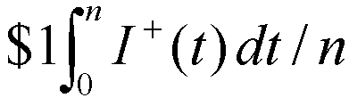
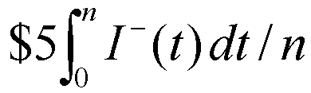
1.5.1 Problem Statement (cont’d.)
Demand in excess of current (physical) inventory is backlogged … so (accounting) inventory could be < 0
Let I(t) be (accounting) inventory level at time t (+, 0, –)
  I⁺(t) = max {I(t), 0} = number of items physically on hand at time t
  I –(t) = max {–I(t), 0} = number of items in backlog at time t
Holding cost: Incur $1 per item per month in (positive) inventory
  Time-average (per month) holding cost =
Shortage cost: Incur $5 per item per month in backlog
  Time-average (per month) backlog cost =
Average total cost per month: Add ordering, holding, shortage costs per month
  Try different (s, S) combinations to try to reduce total cost

Slide 45
1.5.2 Program Organization and Logic
State variables: Inventory level, amount of an outstanding order, time of the last (most recent) event
Events:
  1. Arrival of an order from the supplier
  2. Demand for the product
  3. End of the simulation after n = 120 months
  4. Inventory evaluation (maybe ordering) at beginning of a month
Random variates needed
  Interdemand times: exponential, as in queueing model
  Delivery lags ~ U(0.5, 1): 0.5 + (1 – 0.5)U, where U ~ U(0, 1)
  Demand sizes: Split [0, 1] into subintervals of width 1/6, 1/3, 1/3, 1/6; generate U ~ U(0, 1); see which subinterval U falls in; return X = 1, 2, 3, or 4, respectively
Why the ordering
of event types
3 and 4?

Slide 46
1.5.4 C Program;
1.5.5 Simulation Output and Discussion
Refer to pp. 64-66, 73-79 in the book (Figures 1.43-1.46, 1.57-1.67) and the file inv.c
  Figure 1.57 – external definitions (at top of file)
  Figure 1.58 – function main
  Figure 1.59 – function initialize
  Figure 1.60 – function order_arrival (flowchart: Figure 1.43)
  Figure 1.61 – function demand (flowchart: Figure 1.44)
  Figure 1.62 – function evaluate (flowchart: Figure 1.45)
  Figure 1.63 – function report
  Figure 1.64 – function update_time_avg_stats (flowchart: Figure 1.46)
  Figure 1.65 – function random_integer
  Figure 1.66 – function uniform
  Figure 1.67 – output report inv.out
    Reaction of individual cost components to changes in s and S … overall?
    Uncertainty in output results (this was just one run)?

Slide 47
1.6 ALTERNATIVE APPROACHES TO MODELING AND CODING SIMULATIONS
Parallel and distributed simulation
  Various kinds of parallel and distributed architectures
  Break up a simulation model in some way, run the different parts simultaneously on different parallel processors
  Different ways to break up model
    By support functions – random-number generation, variate generation, event-list management, event routines, etc.
    Decompose the model itself; assign different parts of model to different processors – message-passing to maintain synchronization, or forget synchronization and do “rollbacks” if necessary … “virtual time”
Web-based simulation
  Central simulation engine, submit “jobs” over the web
  Wide-scope parallel/distributed simulation

Slide 48
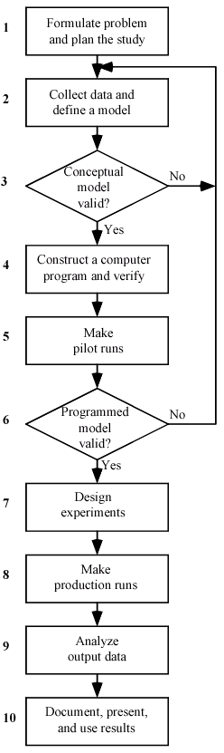
1.7 STEPS IN A SOUND SIMULATION STUDY

Slide 49
1.8 OTHER TYPES OF SIMULATION
Continuous simulation
  Typically, solve sets of differential equations numerically over time
  May involve stochastic elements
  Some specialized software available; some discrete-event simulation software will do continuous simulation as well
Combined discrete-continuous simulation
  Continuous variables described by differential equations
  Discrete events can occur that affect the continuously-changing variables
  Some discrete-event simulation software will do combined discrete-continuous simulation as well

Slide 50
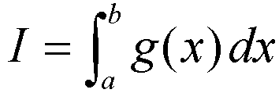
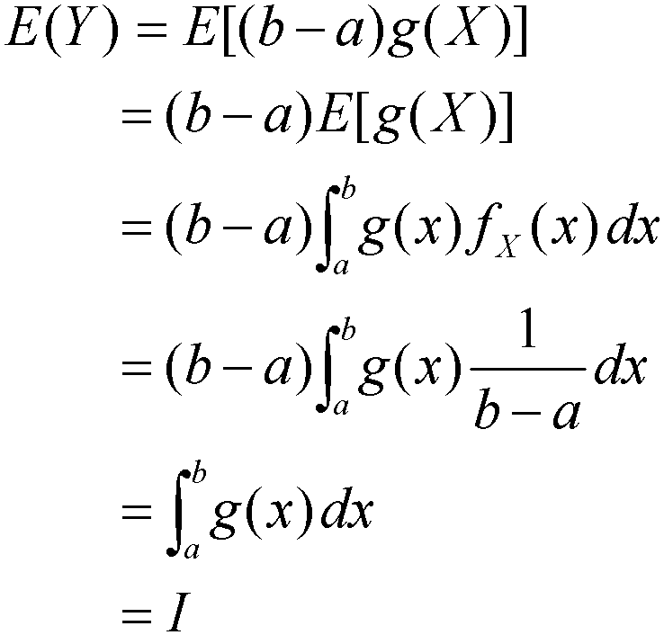
1.8 Other Types of Simulation (cont’d.)
Monte Carlo simulation
  No time element (usually)
  Wide variety of mathematical problems
  Example: Evaluate a “difficult” integral
    Let X ~ U(a, b), and let Y = (b – a) g(X)
    Then
    Algorithm: Generate X ~ U(a, b), let Y = (b – a) g(X); repeat; average the Y’s … this average will be an unbiased estimator of I

Slide 51
1.9 ADVANTAGES, DISADVANTAGES, AND PITFALLS OF SIMULATION
Advantages
  Simulation allows great flexibility in modeling complex systems, so simulation models can be highly valid
  Easy to compare alternatives
  Control experimental conditions
  Can study system with a very long time frame
Disadvantages
  Stochastic simulations produce only estimates – with noise
  Simulation models can be expensive to develop
  Simulations usually produce large volumes of output – need to summarize, statistically analyze appropriately
Pitfalls
  Failure to identify objectives clearly up front
  In appropriate level of detail (both ways)
  Inadequate design and analysis of simulation experiments
  Inadequate education, training

